Slide 1
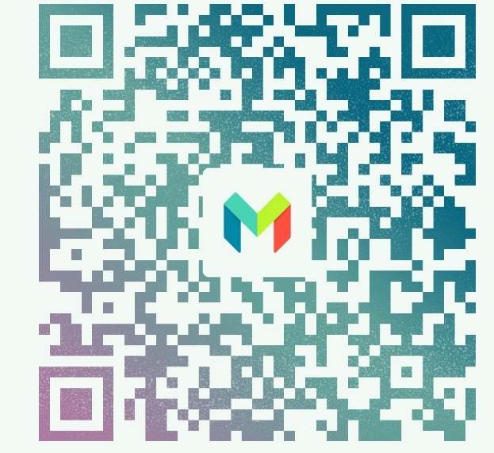
Pay the bank for your purchase account holders name Gina Francis Somani, pay Gina directly with this QR code Enter the agreed price £8.99 * quantity * different packages 1-8
Pay by payment link: https://monzo.me/ginasomani?h=V7VXtM

